Slide 1

AquaSoft
Water Park Management Software
Web Application integrated
with RFID technology, automating park's
ticketing to exit.
Design & Develop by
ADD Pearlinfo Pvt. Ltd.

Slide 2

AGENDA
1
Company Introduction
2
Aquasoft Features
3
AquaSoft Views
4
Pearlinfo Software Products & Services

Slide 3
COMPANY INTRODUCTION
Brief introduction about Pearlinfo Group

Slide 4
OUR COMPANY
Welcome to the Pearlinfo group, where we strive to add value to your business & can contribute to making your company a shining Pearl in your business sector.
We are a leading ISO 9001-2015 software development company, providing reliable & customer satisfaction solutions since 27 years. We specialize in developing automation based software powered by analytics & reporting.
We are LRA for Digital Signature Certificate for all purposes since last 15 years & have issued more than 10 lac DSC across India & abroad.

Slide 5
About AquaSoft
What is Aquasoft & it’s features

Slide 6
Aqua Soft
Waterpark Management Software
Aqua Soft, an all in one solution, from ticketing to wave off, reducing traditional and manual interference.
Aqua Soft which is a web based application integrated with water proof RFID wrist band technology, aims to speed up the routine process, reinvest in delivering customer base services and helps in relaxation of staffs, time and effort.
The web app automates all tasks inside the theme park including cashless transactions, reduction of agent’s, inventory management, sales of food & beverages, costume & lockers and many more...

Slide 7
FEATURES
03
Ticketing
RFID Integration
Exit Process
Easy ticket issuance with balance loading in RFID band.
Single mode of payment to use all park facilities with recharge service from any point
Pay the unused band balance & return band
Clothing Articles
Locker
Restaurant
Rented clothing articles issuance & return
Rent out storage lockers
Manage restaurant item master, inventory & billing

Slide 8
FEATURES
Gift Store
Vendor Management
Sales & Payment Reports
Gift articles inventory management & billing
Manage purchases from Vendors for restaurant, park & gift shop.
Day to day reports &summary
for each center within park
Data Backup
Role Based Access
Log report
Facilitates data backup as per requirement
Create user with required rights for each role.
Maintain counter wise logs

Slide 9
AquaSoft Views
Working screens of Aquasoft

Slide 10
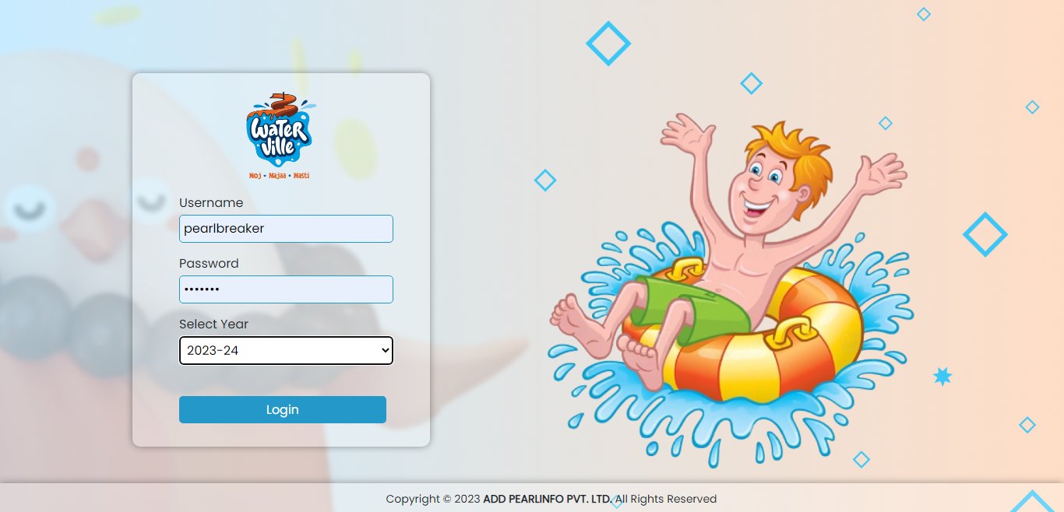
Login Page

Slide 11
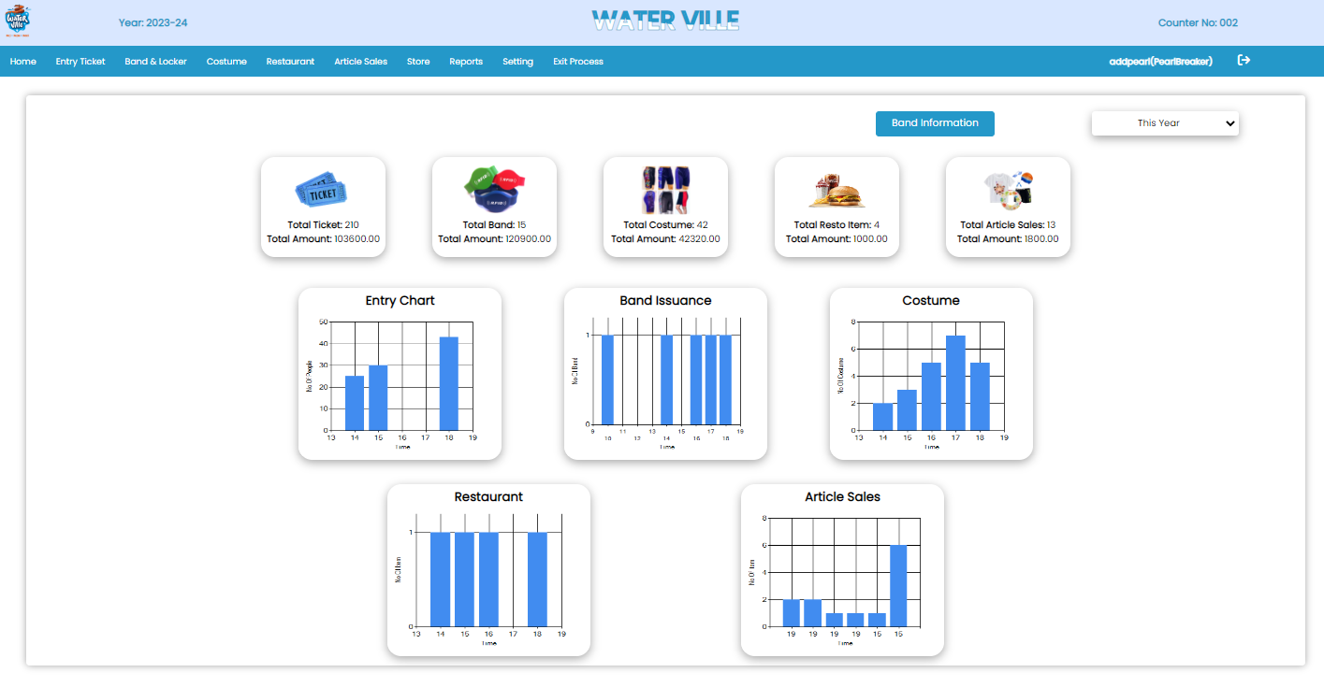
Dashboard

Slide 12
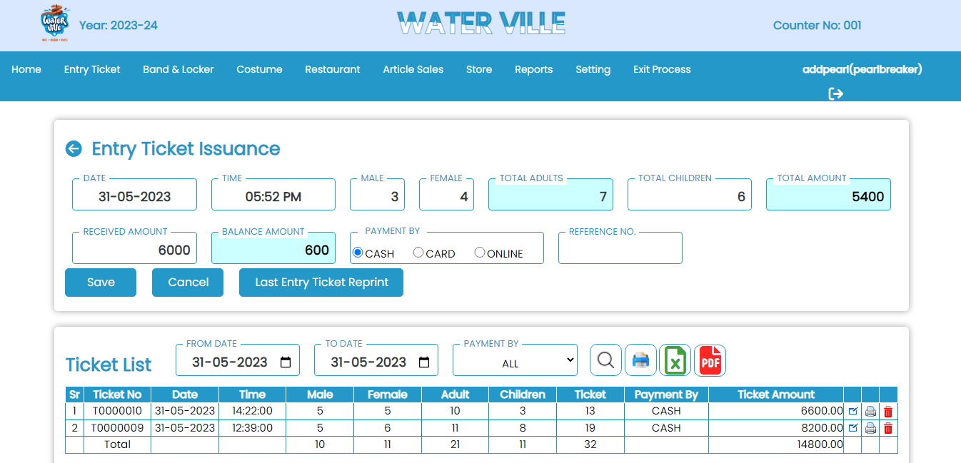
Entry Tickets

Slide 13
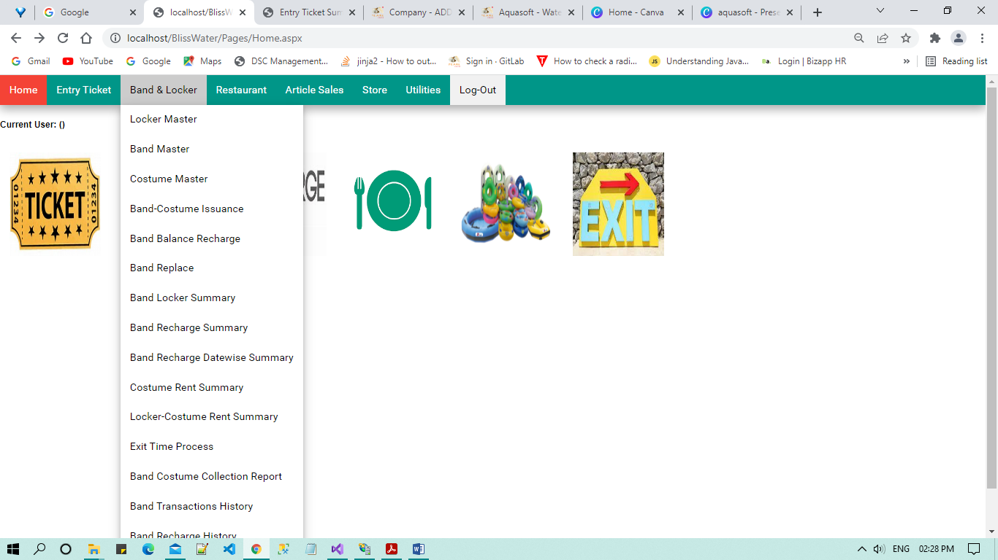
Band & Locker
Restaurant Item Master
Locker Master
Band Master
Costume Master
Band Costume Issuance
Band Balance Recharge
Band Replace
Band Locker Summary
Band Recharge Datewise Summary
Costume Rent Summary
Locker-Costume rent summary
Locker - Costume rent Summary
Exit Time Process
Band costume Collection Report
Band Recharge History
Missing Band Summary

Slide 14
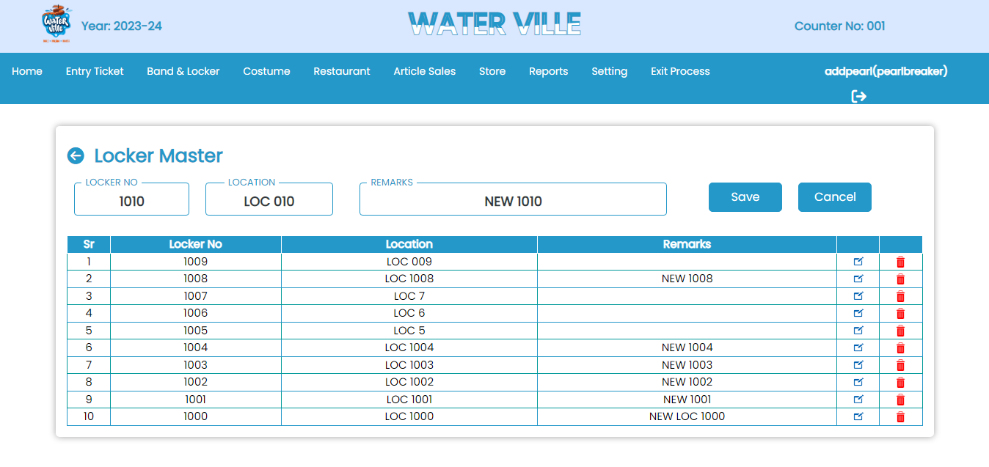
Locker Master

Slide 15
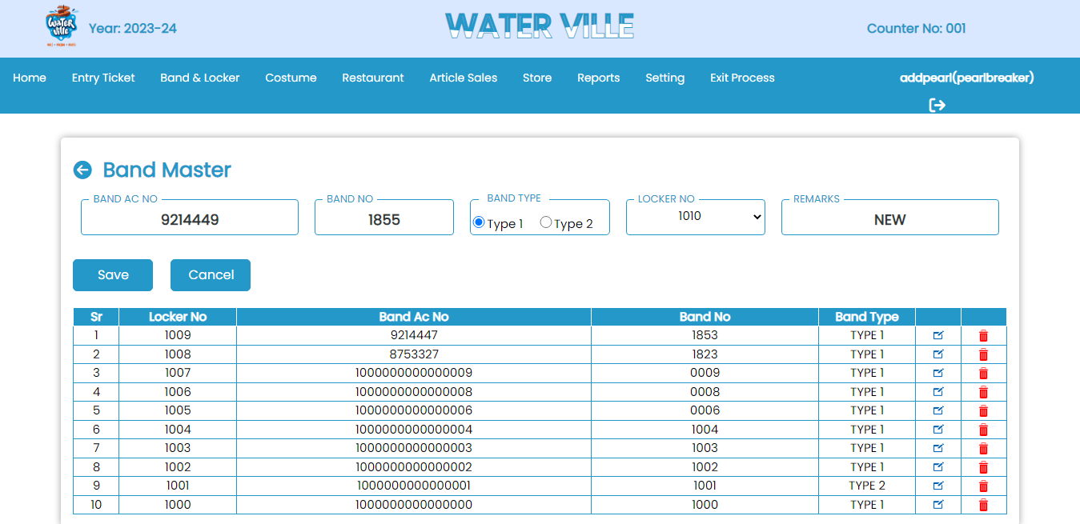
Band Master

Slide 16
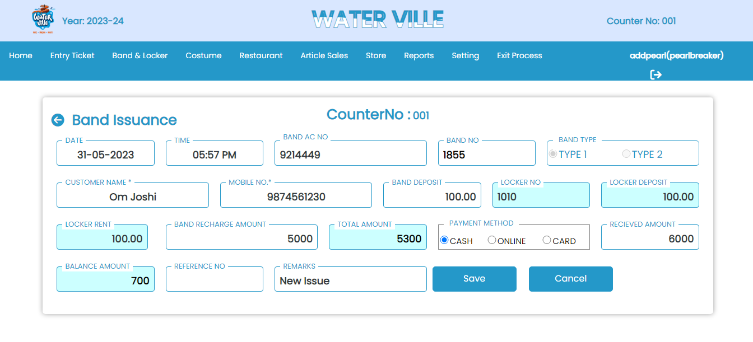
Band Issuance

Slide 17
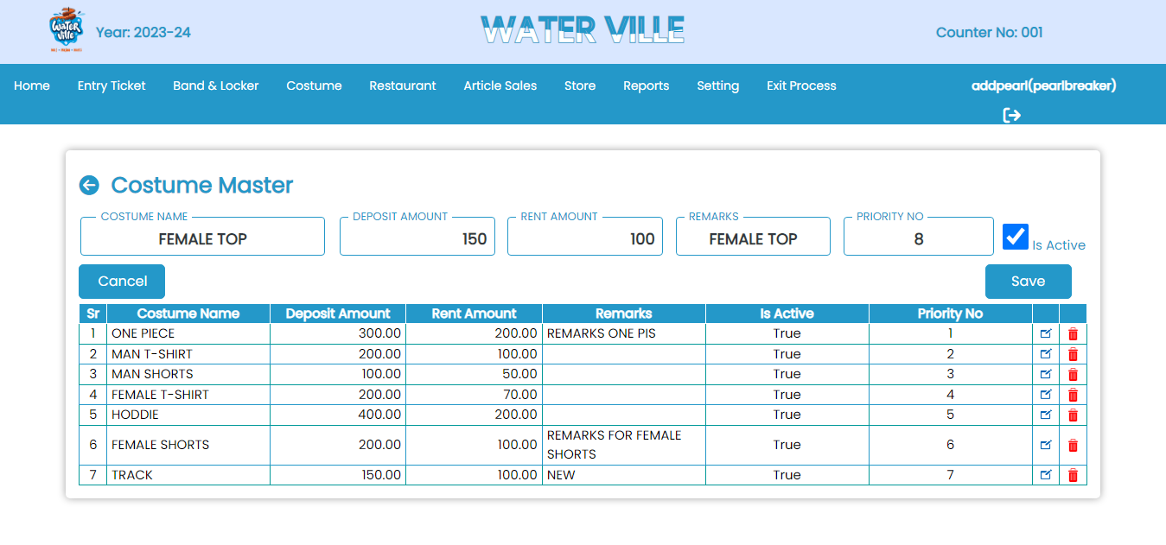
Costume Master

Slide 18
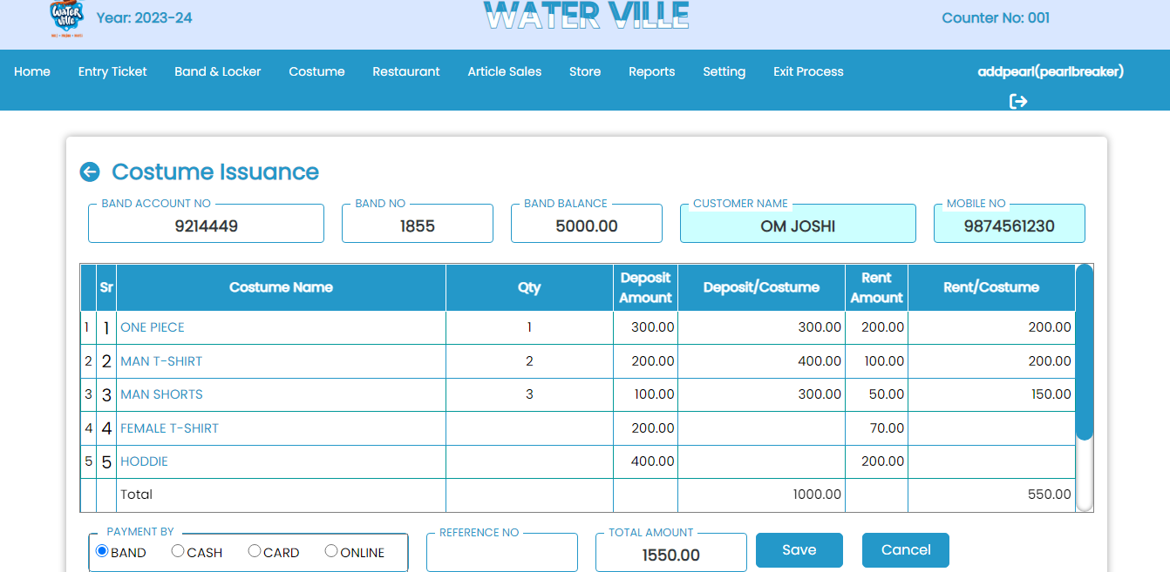
Costume Issuance

Slide 19
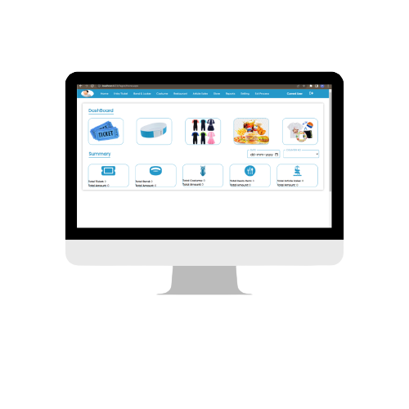
Restaurant
Restaurant Item Master
Restaurant Master
Restaurant User Assign
Restaurant Counter Master
Restaurant Item Issuance
Restaurant Daily Collection Report
Restaurant Sales Register
Restaurant Summary Report

Slide 20
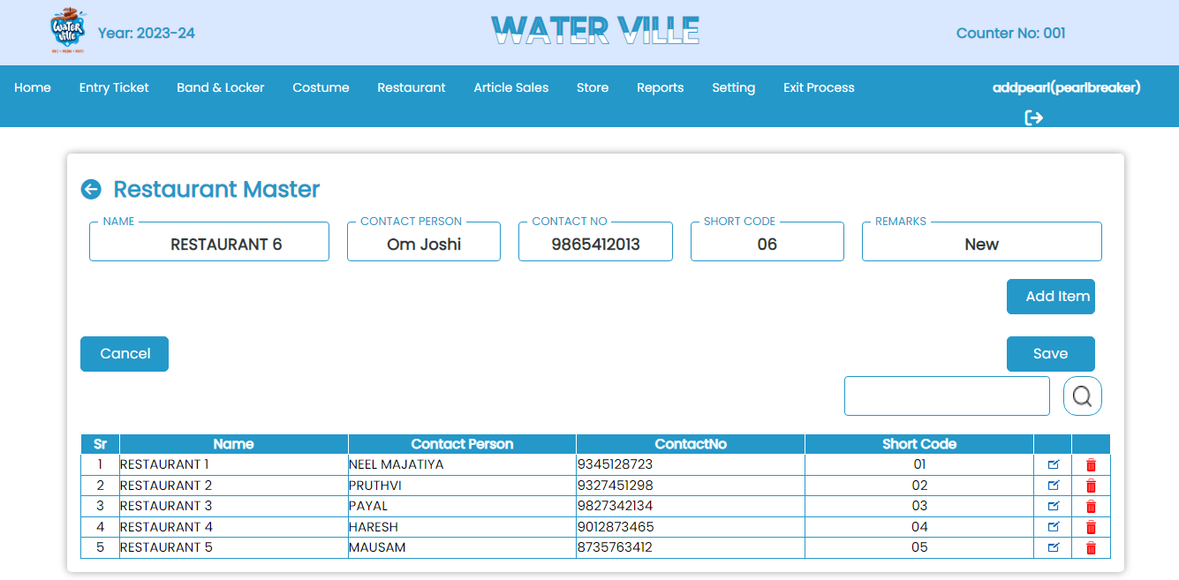
Restaurant Master

Slide 21
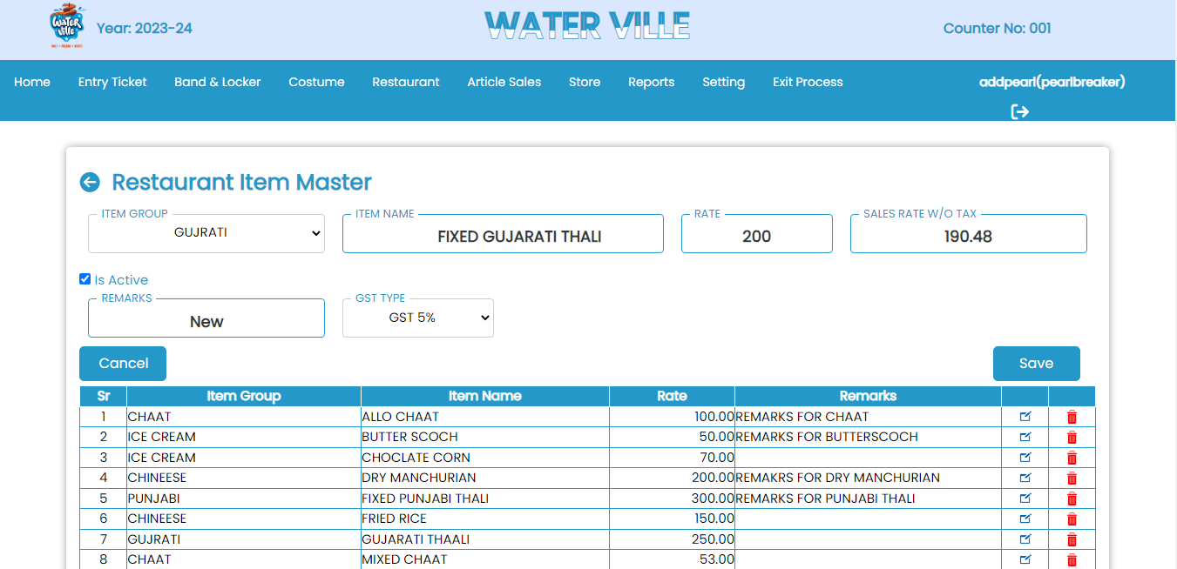
Restaurant Item Master

Slide 22
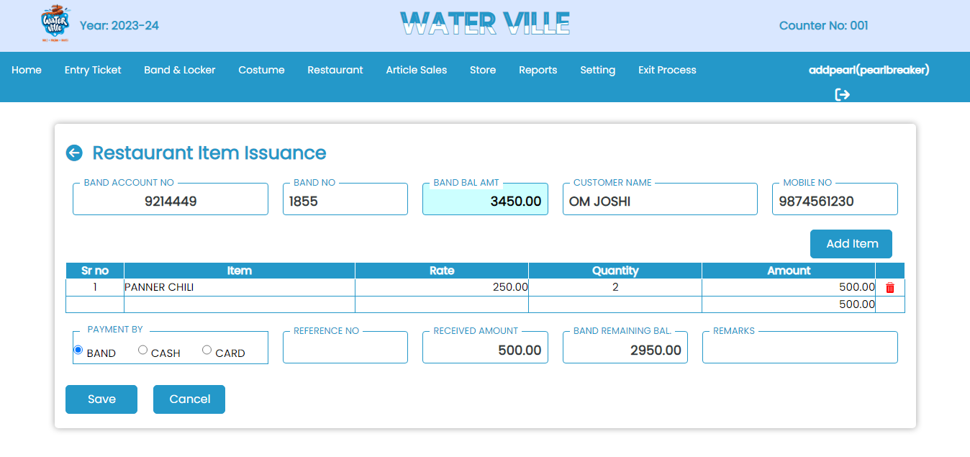
Restaurant Item Issuance

Slide 23
Article Sales
Article Sales Entry
Article Sales Daily Collection Report
Article Sales Summary
Article Stock Status

Slide 24
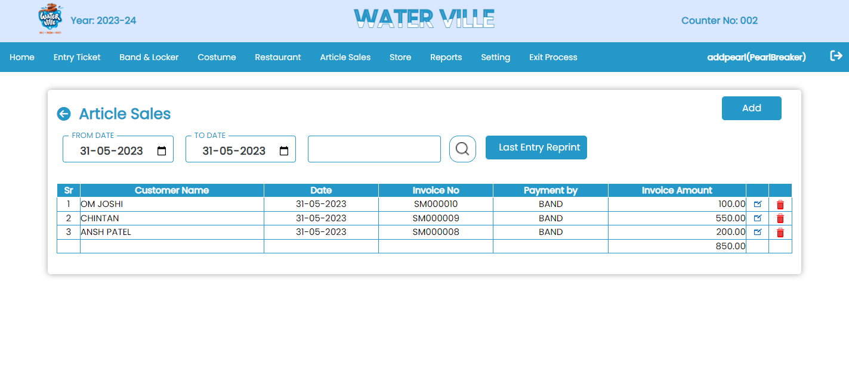
Article Sales List

Slide 25
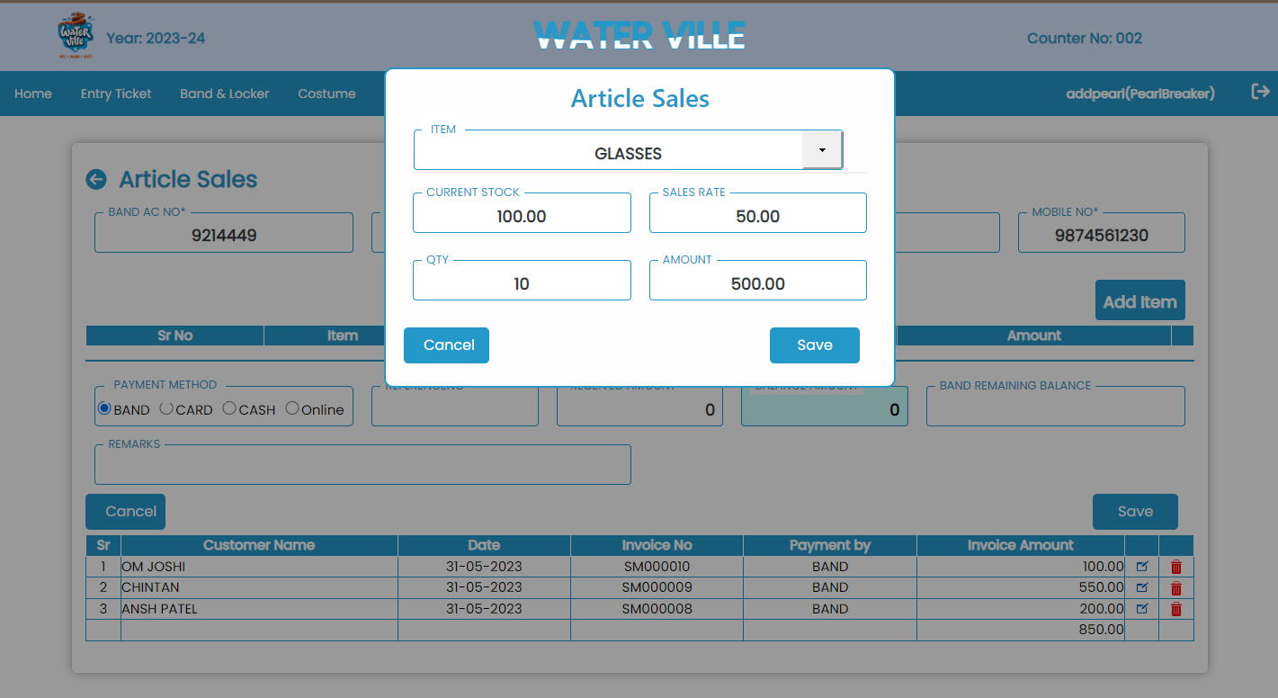
Article Sales Entry

Slide 26
Store
Supplier Master
Store Item Master
PRN Entry
Indent Generation
Indent Issue Slip
Store Gatepass
Stock Entry
Stock Status

Slide 27
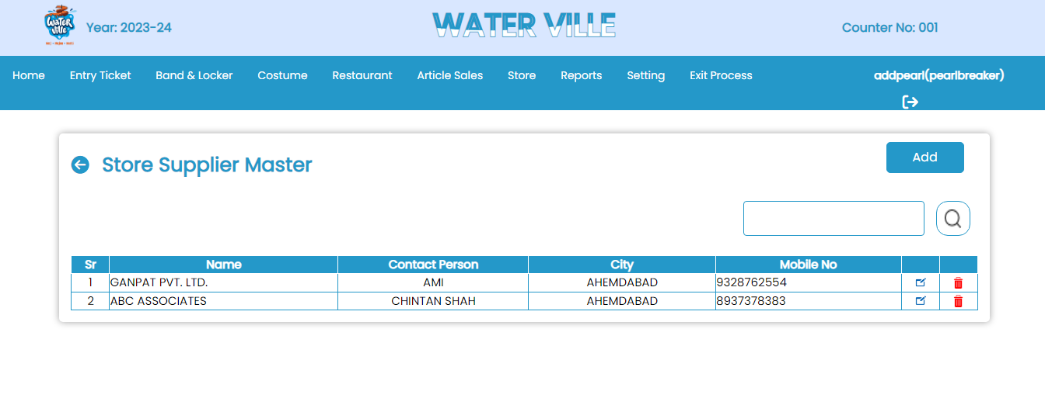
Store Supplier Master

Slide 28
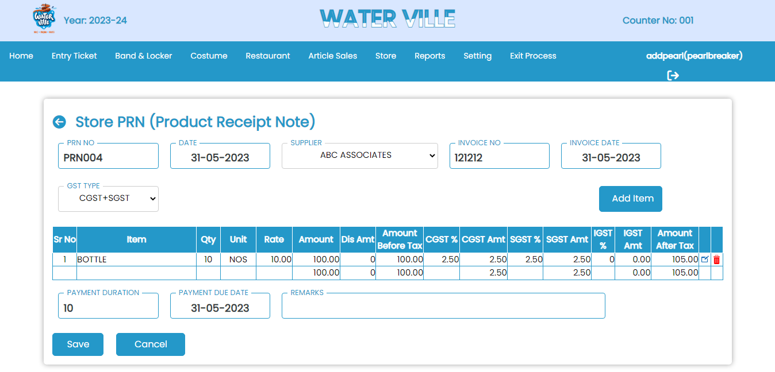
Store PRN (Product Receipt Note)

Slide 29
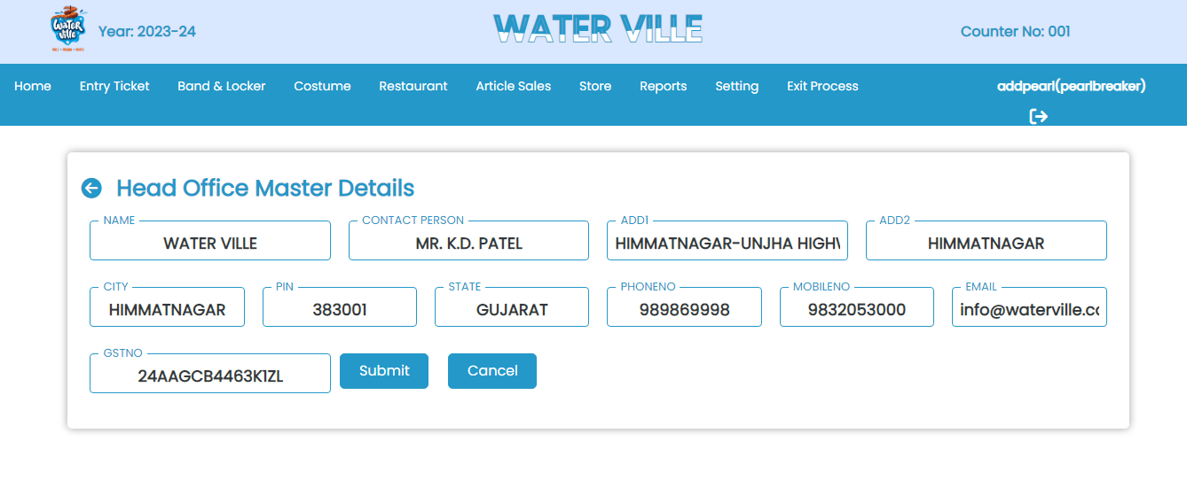
Head Office Master

Slide 30
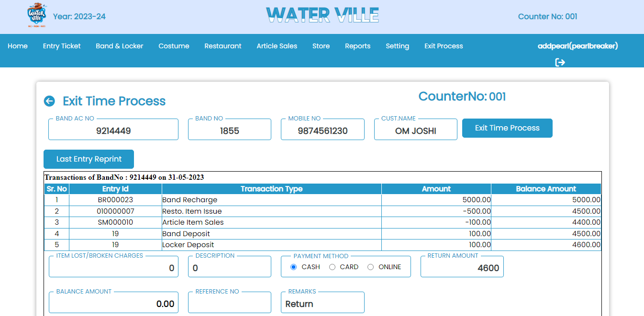
Exit Time Process

Slide 31
Utilities
Waterpark Main Detail
Income Status Report
Counter Ledger
Daily Cash Collection
Parameters
Department Master
Financial Year
Year End Process
Counter Master
Counter Company Cash
Print Log Report
Summary Report
Collection Summary Report
User Rights
Tax Type Master
Employee Master
Change Password

Slide 32
Pearlinfo Softwares
Brief information on Pearlinfo services & products

Slide 33

PEARLINFO SERVICES
CUSTOMIZED SOFTWARE & MOBILE APP DEVELOPMENT SERVICE
DIGITAL SIGNATURE CERTIFICATE ISSUANCE SERVICE
DATA & BUSINESS ANALYTICS SERVICE
WEBSITE DESIGNINIG & DEVELOPMENT SERVICE

Slide 34
PEARLINFO PRODUCTS
PEARL BILL
BILLING & INVENTORY MANAGEMENT SOFTWARE
PEARL ESIGN
PDF SIGNING SOFTWARE
(WINDOWS, LINUX, TALLY, API)
SPRO
An ERP FOR PROFESSIONALS
TechSalon
Salon & Spa Management Software

Slide 35

Thanks
Do you have any questions?
info@pearlinfo.in
+91-9426062643
https://pearlinfo.in

