Slide 1



BACKEND SOLUTION FOR
PROFESSIONALS
DESIGNED & DEVELOPED BY
ADD PEARLINFO PVT.LTD

Slide 2

Agenda
1
Company Introduction
2
Business Problem
3
SPRO Business Solution
4
4
Pearlinfo Products
5
Pearlinfo Services

Slide 3
01
COMPANY INTRODUCTION

Slide 4
OUR COMPANY
Welcome to the Pearlinfo group where we strive to add value to your business & can contribute to making your company a shining Pearl in your business sector.
We are a leading ISO 9001-2015 certified software development company, providing reliable & customer satisfaction solutions since 27 years. We specialize in developing automation based software powered by analytics & reporting.
We are LRA for Digital Signature Certificate for all purposes since last 15 years & have issued more than 10 lac DSC across India & abroad.

Slide 5
02
SPRO Business Problem
What is the business / functionality gap in market

Slide 6


Business Gap in Existing
Scattered / Individual solutions for each module
Expensive software solutions
Foreign-based software that is non-compliant with the Indian Economical scenario
Unavailability of only Service based solutions for easy business management

Slide 7
03
SPRO Business Solution
What is SPRO & how it resolves
the business problem ?

Slide 8



What is SPRO?
Scalable and deployable for large & small scale businesses
SPRO is a web & mobile-based software solution that completely automates a service-based business with live business updates.
Why SPRO?
Live dashboard reporting current business scenario
Saves valuable hours of management for task tracking & billing.
Budget-friendly solution
Easy to use & User-friendly interface

Slide 9








Task Management
KEY FEATURES
Client Management
Employee Management
Processes can be streamlined with an efficient auto allocation and reporting.
System for managing and tracking information for each client.
Manage your employees' work assignments and reports with ease.
Document Management
Account Management
Appointment Booking
Paperless office concept to efficiently store and access documents.
a billing system with advanced account management.
a billing system with advanced account management.

Slide 10
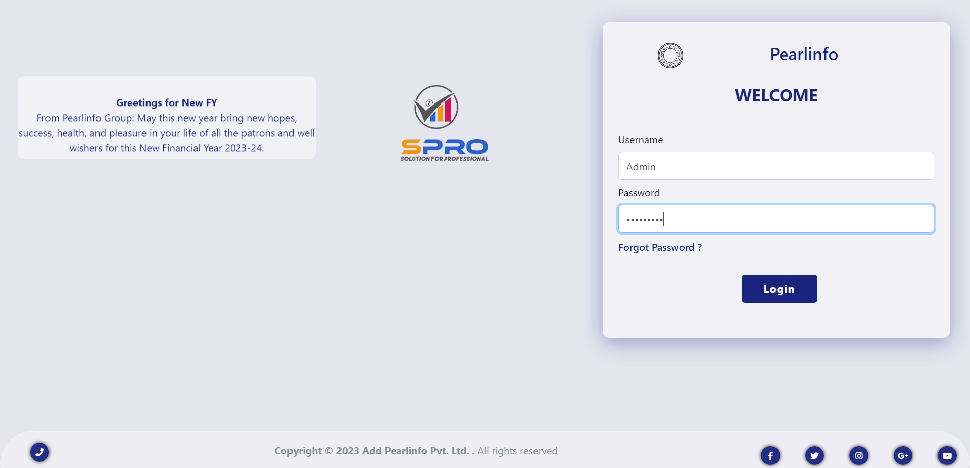
PREVIEW OF SPRO

Slide 11
04
Pearlinfo Softwares
Brief introduction of our other software
product & services

Slide 12
PEARLINFO SOFTWARE
PRODUCTS
PEARL BILL – BILLING & INVENTORY MANAGEMENT SOFTWARE
AQUASOFT – WATERPARK MANAGEMENT SOFTWARE
PEARL ESIGN - PDF SIGNING SOLUTION ( Web app, Mobile app, API, Tally Addon, Desktop & Linux based)
TECHSALON – SPA & SALON MANAGEMENT SOFTWARE
EGURUKUL – HOSTEL MANAGEMENT SOFTWARE

Slide 13
PEARLINFO SOFTWARE
SERVICES
CUSTOMIZED SOFTWARE DEVELOPMENT SERVICES
DIGITAL SIGNATURE CERTIFICATE ISSUANCE SERVICES
DATA & BUSINESS ANALYTICS SERVICES
WEBSITE DESIGNINIG & DEVELOPMENT SERVICES

Slide 14
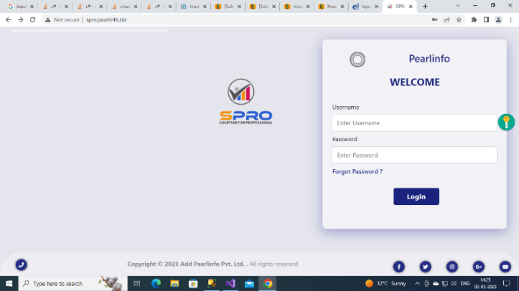
FREE TRIAL
THANKS!
Do you have any questions?
https://pearlinfo.in
+91 8320886672
info@pearlinfo.in

